Slide 2
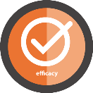
KABATAANG [K]-PACK
Nation of Heroes III
DepEd K-12 Youth Summit

Slide 3
My K-Pack is the best buddy to go with in the successful road of life.
Skills matter
for success

Slide 4
Three Simple Reminders

Slide 5
BE LIKE A CHILD.
BE LIKE AN ADULT.
BE LIKE A PARENT.
Be like a CHILD who loves to PLAY
Be like an ADULT who ANALYSES
Be like a PARENT who CARES
2
1
3

Slide 6
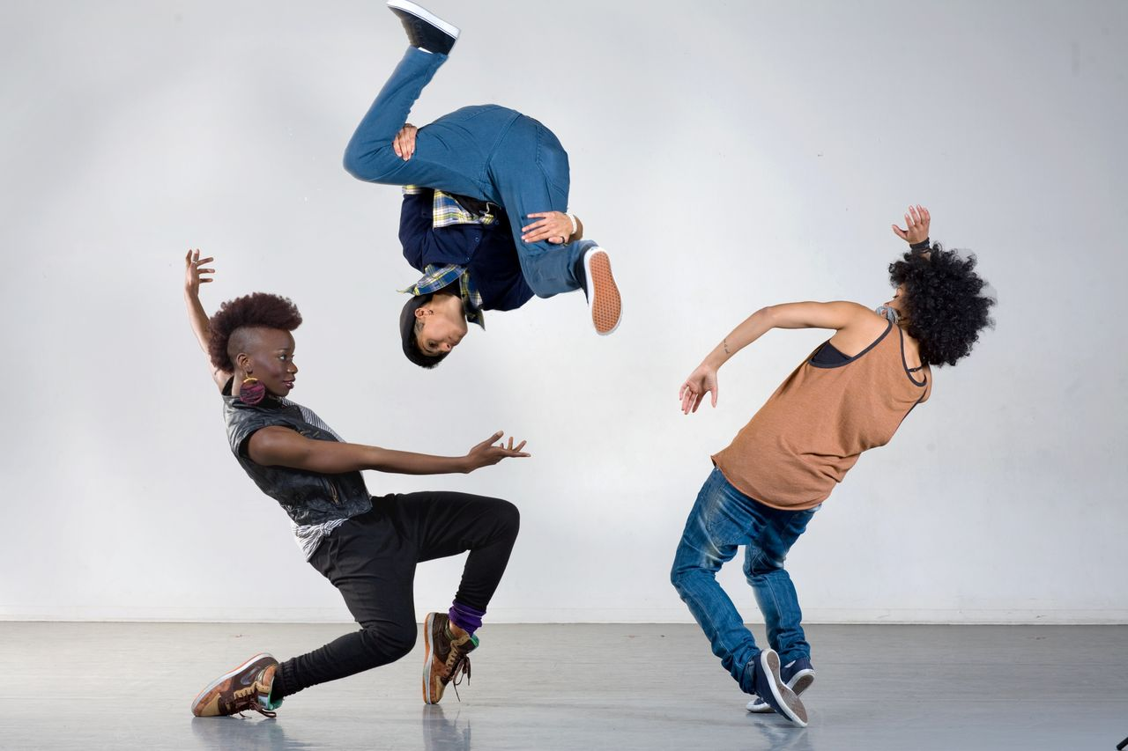
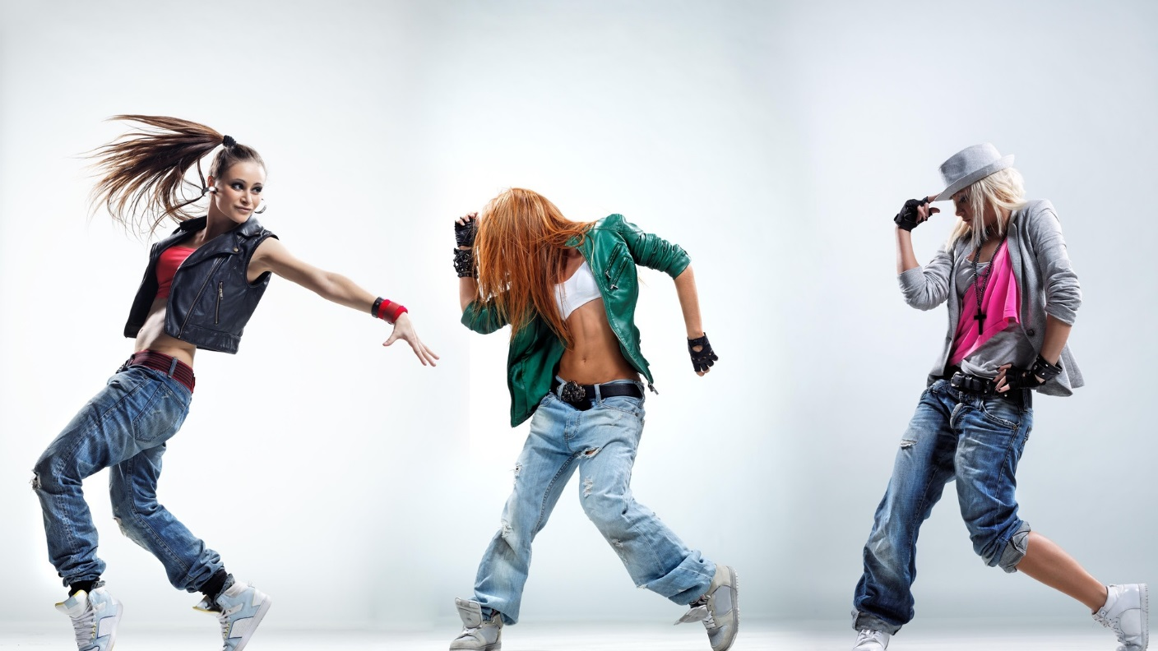
Dance Exercise

Slide 7
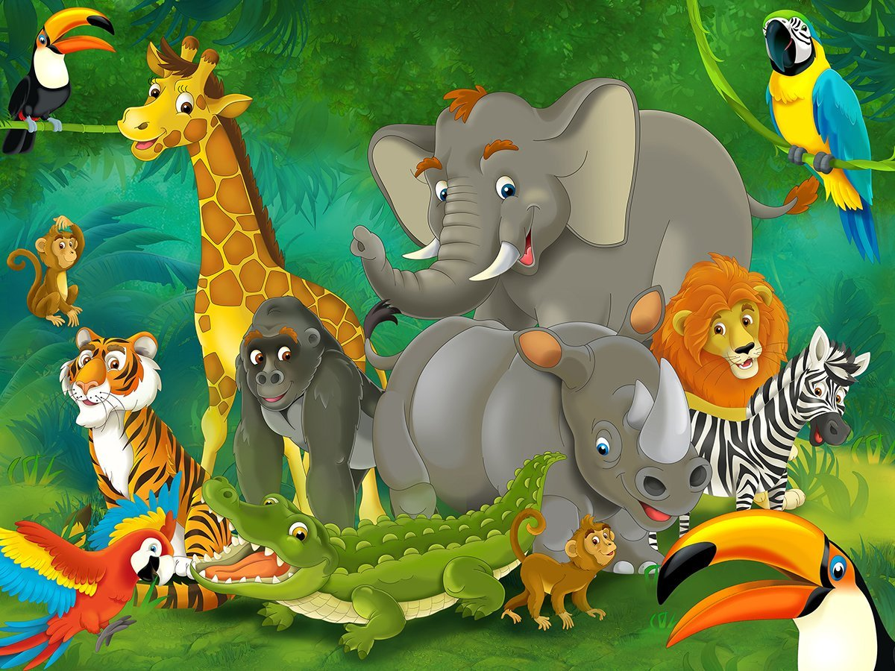
Vet on Your Baby!

Slide 8
Eagle
What are your ambitions, dreams and goals in life?

Slide 9
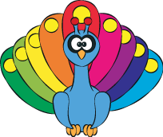
Peacock
What are you proud of yourself?

Slide 10
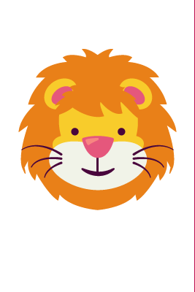
Lion
What are your strengths?

Slide 11
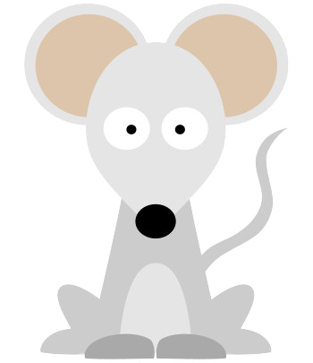
Mouse
What are your weaknesses?

Slide 12
Elephant
Who are your inspirations in life?

Slide 13
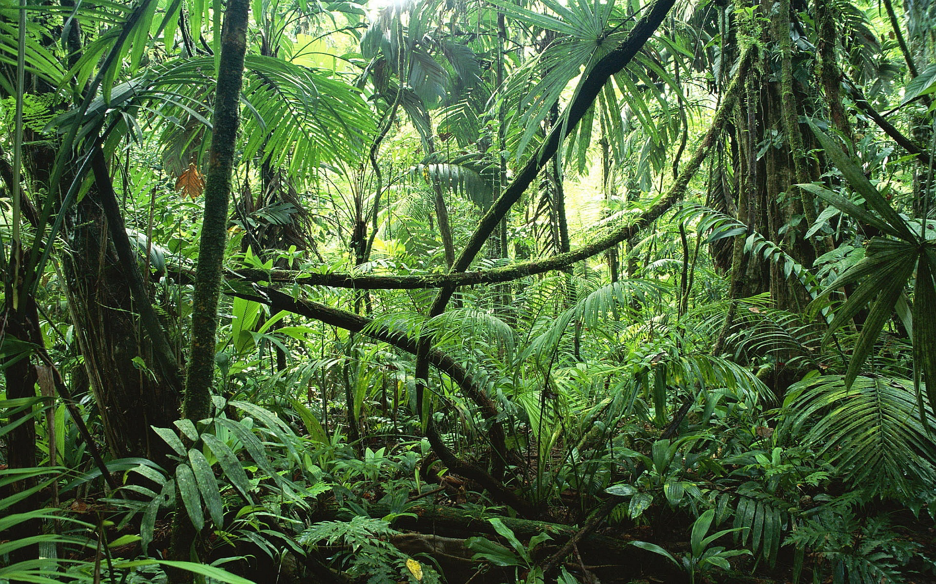
In the Jungle

Slide 14
There’s a mango in the jungle,
in the jungle, in the jungle (3x)
There’s a mango in the jungle
HEY!
IN THE JUNGLE

Slide 15
There’s a FROG in the jungle,
in the jungle, in the jungle (3x)
There’s a FROG in the jungle, hey!
IN THE JUNGLE

Slide 16
There’s a PARROT in the jungle,
in the jungle, in the jungle (3x)
There’s a PARROT in the jungle, hey!
IN THE JUNGLE

Slide 17
There’s a DUCK in the jungle,
in the jungle, in the jungle (3x)
There’s a DUCK in the jungle, hey!
IN THE JUNGLE

Slide 18
There’s a PIG in the jungle,
in the jungle, in the jungle (3x)
There’s a PIG in the jungle, hey!
IN THE JUNGLE

Slide 19
There’s a TIGER in the jungle,
in the jungle, in the jungle (3x)
There’s a TIGER in the jungle, hey!
IN THE JUNGLE

Slide 20
There’s a PIRANHA in the jungle,
in the jungle, in the jungle (3x)
There’s a PIRANHA in the jungle, hey!
IN THE JUNGLE

Slide 21
There’s an ANACONDA in the jungle,
in the jungle, in the jungle (3x)
There’s an ANACONDA in the jungle, hey!
IN THE JUNGLE

Slide 22
There’s a MONKEY in the jungle,
in the jungle, in the jungle (3x)
There’s a MONKEY in the jungle, hey!
IN THE JUNGLE

Slide 23
Let us go with the mango, frog, parrot, to the jungle
Let us go with the duck, pig, tiger, to the jungle
Let us go with the piranha, anaconda, monkey, to the jungle
Having fun in the jungle hey!
IN THE JUNGLE

Slide 24
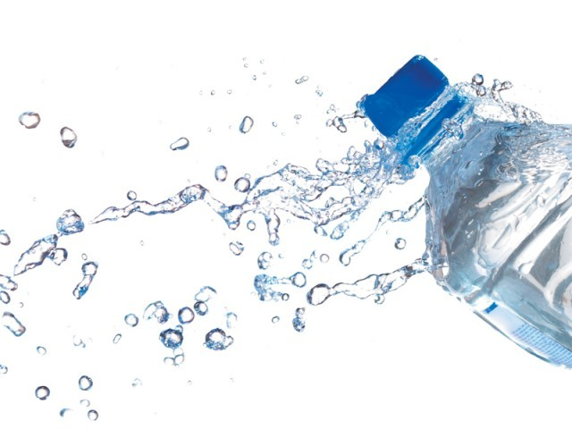
Tumblr It To Stand

Slide 25
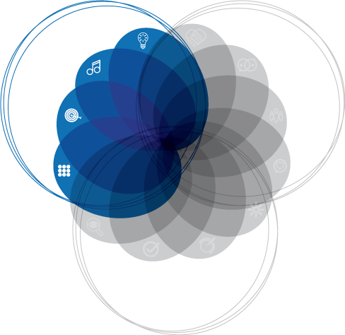
FIRST SKILL
Achieving.

Slide 26
ACHIEVING.
ACHIEVING means building better understanding in oneself by:
identifying and improving the skills you have
practicing those you don’t have
utilizing them to attain goals in life
FIRST SKILL LESSON

Slide 27
ACHIEVING.
Core Skills
Critical Thinking
FIRST SKILL LESSON

Slide 28
ACHIEVING.
Core Skills
Creativity
FIRST SKILL LESSON

Slide 29
ACHIEVING.
Core Skills
Goal Focus
FIRST SKILL LESSON

Slide 30
ACHIEVING.
Core Skills
Organization
FIRST SKILL LESSON

Slide 31
ACHIEVING.
”What you get by achieving your goals is not as important as what you become by achieving your goals”
- Zig Ziglar
FIRST SKILL LESSON

Slide 32
ACHIEVING.
K-Pack – Ruler Inside.
Have a straightforward direction towards your goals.
FIRST SKILL LESSON

Slide 33
ACHIEVING.
Align your day-to-day activities to your goals. Always make it a point to FOCUS; never straying from the right path of success. Trace a straight path towards the best you.
FIRST SKILL LESSON

Slide 34
STOMP THE YARD
ACHIEVING
FIRST SKILL LESSON

Slide 35
Lulalu

Slide 36
Lulalulalula lulalulaley
Lulalulalulaley
(repeat)
Lulalu

Slide 37
Put your right hand in
Put your right hand out
Put your right hand in
And you shake it all around
And dance the boogie boogie and turn around
Let us praise the Lord
LULALU

Slide 38
Put your right shoulder in
….
LULALU

Slide 39
Put your right foot in
….
LULALU

Slide 40
Put your whole body in
….
LULALU

Slide 41
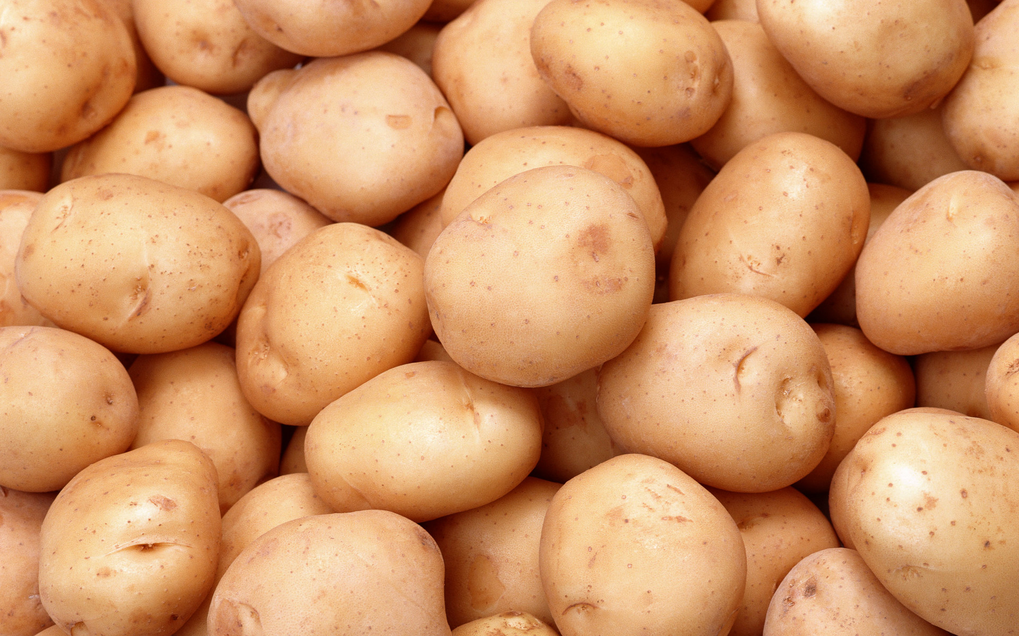
Hot Potatoes

Slide 42
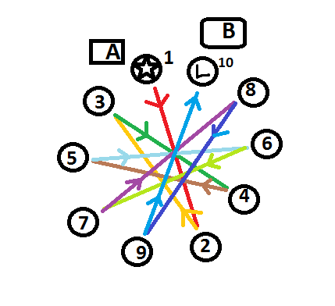
Pattern for Passing

Slide 43
1st Activity
Tumblr It To Stand

Slide 44
FIRST SKILL
Achieving.

Slide 45
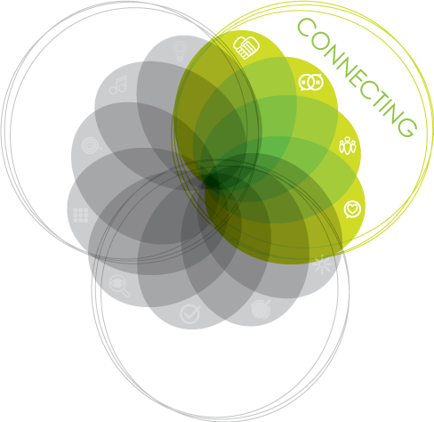
SECOND SKILL
CONNECTING.

Slide 46
CONNECTING.
CONNECTING is the skill where you are able to play your part in a group be it in school, at home, in the community, etc. by doing what you are good at FOR THE GOOD OF OTHERS, THEN YOURSELF.
SECOND SKILL LESSON

Slide 47
CONNECTING.
Core Skills
Relationships
FIRST SKILL LESSON

Slide 48
CONNECTING.
Core Skills
Communication
FIRST SKILL LESSON

Slide 49
CONNECTING.
Core Skills
Teamwork
FIRST SKILL LESSON

Slide 50
CONNECTING.
Core Skills
Respect
FIRST SKILL LESSON

Slide 51
CONNECTING.
“We cannot live only for ourselves. A thousand fibers connect us with our fellow men.
- Herman Melville
SECOND SKILL LESSON

Slide 52
CONNECTING.
K-Pack – Glue Inside.
A glue applied to the surfaces of materials binds them together and resists separation.
FIRST SKILL LESSON

Slide 53
CONNECTING.
We are born to become part of the society therefore a part of one community and one human family. We are to work together to achieve our common goals. There is strength in unity. Each one is different and unique, but equally, each has a vital role towards the common good.
FIRST SKILL LESSON

Slide 54
STOMP THE YARD
CONNECTING
SECOND SKILL LESSON

Slide 55
PI-LI-PI-NO

Slide 56
PI…
PI-LI-PI-O

Slide 57
LI…
PI-LI-PI-O

Slide 58
PI…
PI-LI-PI-O

Slide 59
NO…
PI-LI-PI-O

Slide 60
Candle With Care

Slide 61
1st Activity
Tumblr It To Stand

Slide 62
FIRST SKILL
Achieving.

Slide 63
2nd Activity
Hot Potatoes

Slide 64
SECOND SKILL
CONNECTING.

Slide 65
THIRD SKILL
THRIVING.

Slide 66
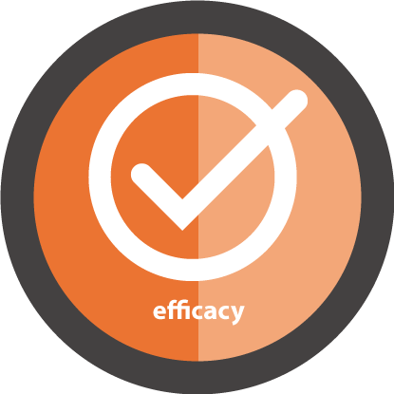
THRIVING.
THRIVING is when you exercise your skills to its highest potentials and share it to others.
THIRD SKILL LESSON

Slide 67
THRIVING.
Core Skills
Wellbeing
THIRD SKILL LESSON

Slide 68
THRIVING.
Core Skills
Drive
THIRD SKILL LESSON

Slide 69
THRIVING.
Core Skills
Efficacy
THIRD SKILL LESSON

Slide 70
THRIVING.
Core Skills
Awareness of Self and others
THIRD SKILL LESSON

Slide 71
THRIVING.
“Let your legacy be how you love, how you treat people, and the light you bring to the world instead of the stuff you leave behind.”
- Anonymous
THIRD SKILL LESSON

Slide 72
THRIVING.
K-Pack – Pencil Inside.
A pencil is a writing utensil.
THIRD SKILL LESSON

Slide 73
THRIVING.
It leaves a mark. Leave a mark (a legacy) in this world. You can start at your young age now by sharing your talents and abilities to others.
THIRD SKILL LESSON

Slide 74
STOMP THE YARD
THRIVING
THIRD SKILL LESSON

Slide 75
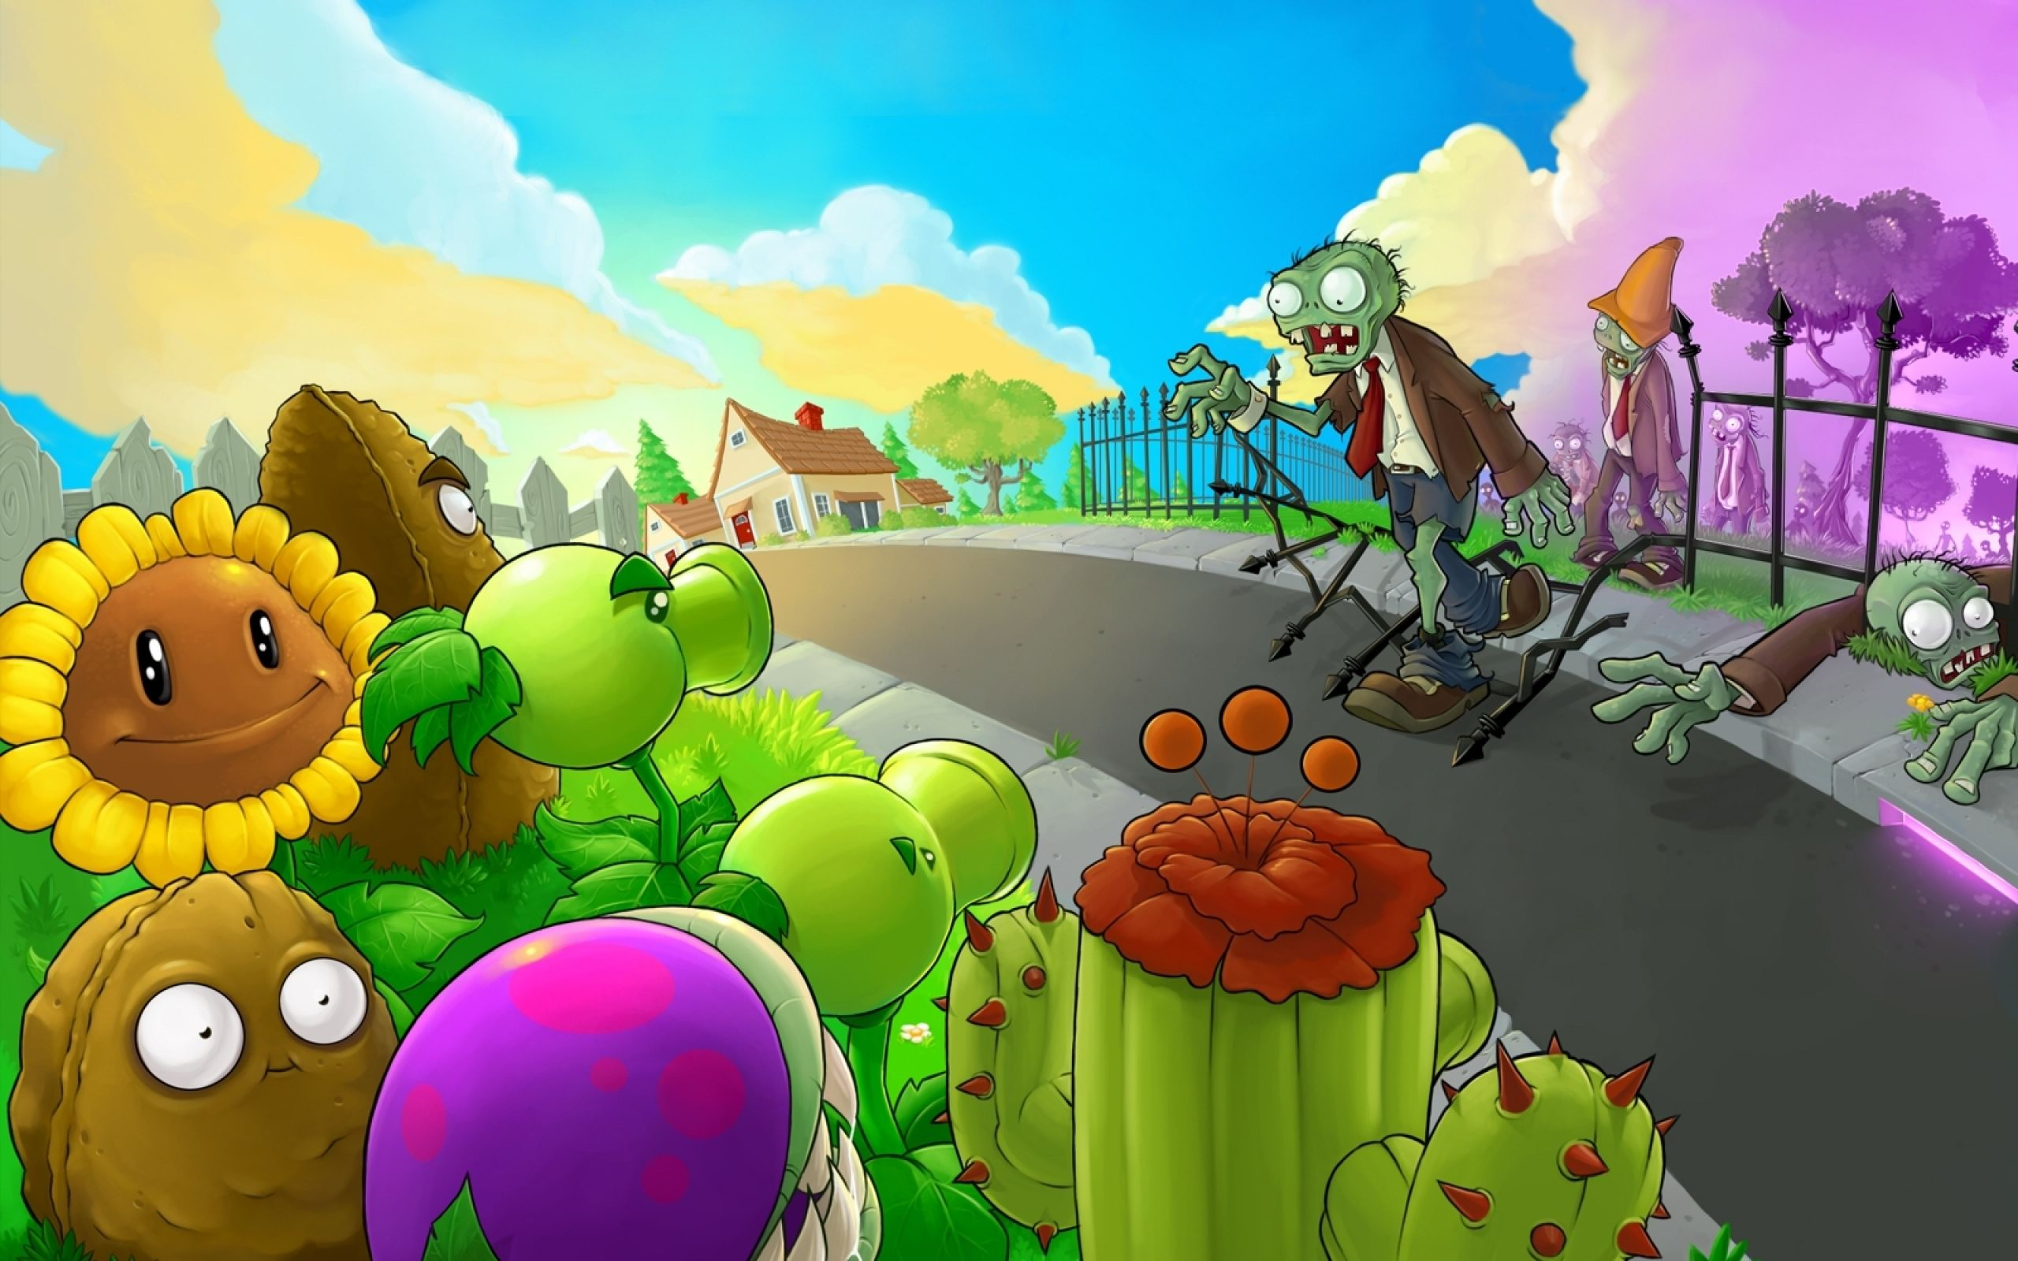
ubuka
Bubuka ang Bulaklak vs Zombies

Slide 76
...Left Arm Edition...
BUBUKA ANG BULAKLAK VS ZOMBIES

Slide 77
...Right Leg Edition...
BUBUKA ANG BULAKLAK VS ZOMBIES

Slide 78
...Left Leg Edition...
BUBUKA ANG BULAKLAK VS ZOMBIES

Slide 79
...Whole Body Edition...
BUBUKA ANG BULAKLAK VS ZOMBIES

Slide 80
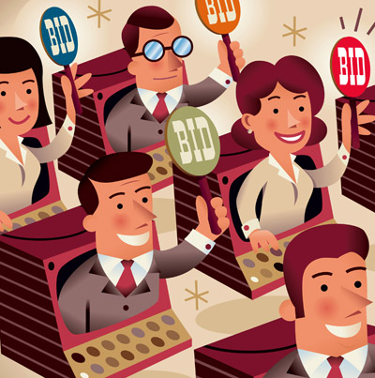
Bid for Me

Slide 81
100,000
70,000
50,000
20,000
10,000
5,000
125,000
BID VALUES

Slide 82
1st Activity
Tumblr It To Stand

Slide 83
FIRST SKILL
Achieving.

Slide 84
2nd Activity
Hot Potatoes

Slide 85
SECOND SKILL
CONNECTING.

Slide 86
Candle With Care
3rd Activity

Slide 87
THIRD SKILL
THRIVING.

Slide 88
4th Activity
Bid for Me

Slide 89
OVERALL SKILL
Fulfillment.

Slide 90
FULFILLMENT
FULFILLMENT is the satisfaction or happiness as a result of fully developing one's abilities or character. One may need contentment but they should at all times settle for being contended. It is best to fully achieve your goals and boost your potentials and be FULFILLED IN LIFE
FOURTH SKILL LESSON

Slide 91
FULFILLMENT
“Only those who have learned the power of sincere and selfless contribution experience life's deepest joy: true fulfillment.”
-Tony Robbins
FOURTH SKILL LESSON

Slide 92
FULFILLMENT.
K-Pack – Paper Inside.
Like paper, everything in this world is fleeting. If we measure our lives as only of less value, we will never ever feel truly happy.
THIRD SKILL LESSON

Slide 93
FULFILLMENT
However, paper may have lasting value as to whoever or whatever is written on it. Let our LIFE BE OF LASTING VALUE BY THE ACHIEVEMENT OF SOMETHING DESIRED, WHICH WAS SHARED TO OUR FRIENDS.
THIRD SKILL LESSON

Slide 94
STOMP THE YARD
FULFILLMENT
FOURTH SKILL LESSON

Slide 95
Si Pilemon: The Sequel

Slide 96
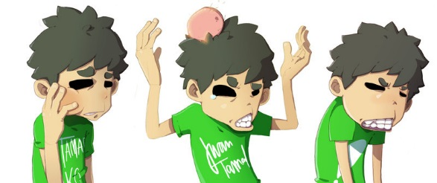
Si Pilemon: The Sequesl

Slide 97
Si Pilemon, si Pilemon,
Nisulod sa eskwelahan
Nakakat-on, nakakat-on,
Ug daghang pagtulun-an
SI PILEMON: THE SEQUEL

Slide 98
Naka-graduate, naka-graduate
With medal ug ribbon...
Successful na jud siya
Kay buotan man siya
Lipay si mama, papa.
SI PILEMON: THE SEQUEL

Slide 99
RECAP

Slide 100
1st Activity
Tumblr It To Stand

Slide 101
FIRST SKILL
Achieving.

Slide 102
2nd Activity
Hot Potatoes

Slide 103
SECOND SKILL
CONNECTING.

Slide 104
Candle With Care
3rd Activity

Slide 105
THIRD SKILL
THRIVING.

Slide 106
4th Activity
Bid for Me

Slide 107
OVERALL SKILL
Fulfillment.

Slide 108
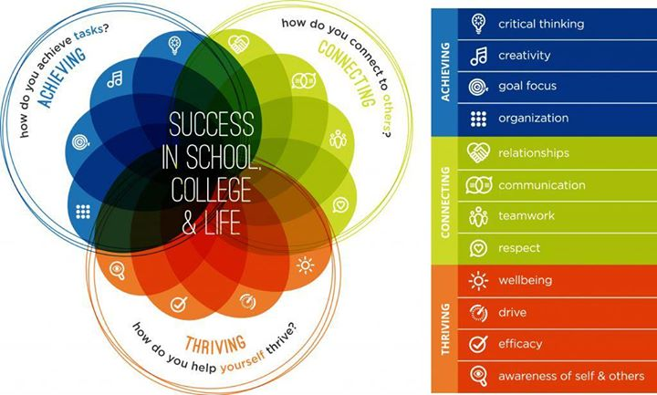

Slide 109
The question is
ARE YOU READY?

Slide 110
READINESS
READINESS is the state of being fully prepared and willing for something. Skills are blessings given by the Almighty. It will be useless without the willingness to use and share them.

Slide 111
READINESS
“Waiting for perfection is not an answer, one cannot say ‘I will be ready when I am perfect’ because then you will never be ready, rather one must say ‘I am raw and I am ready just like this right now, how and who I am.”
-C. JoyBell C.
FOURTH SKILL LESSON

Slide 112
READINESS
K-Pack.
Equip yourselves with all the skills and gather them all inside the K-Pack. God will Provide!
THIRD SKILL LESSON

Slide 113
READINESS
He has always given us all the necessary skills to face boldly the future! The source of all talents, all strengths, all blessings. The Great Provider.
THIRD SKILL LESSON

Slide 114
SIYA ANG PALAGING KASAMA NG KABATAANG MAY K!

